Slide 1
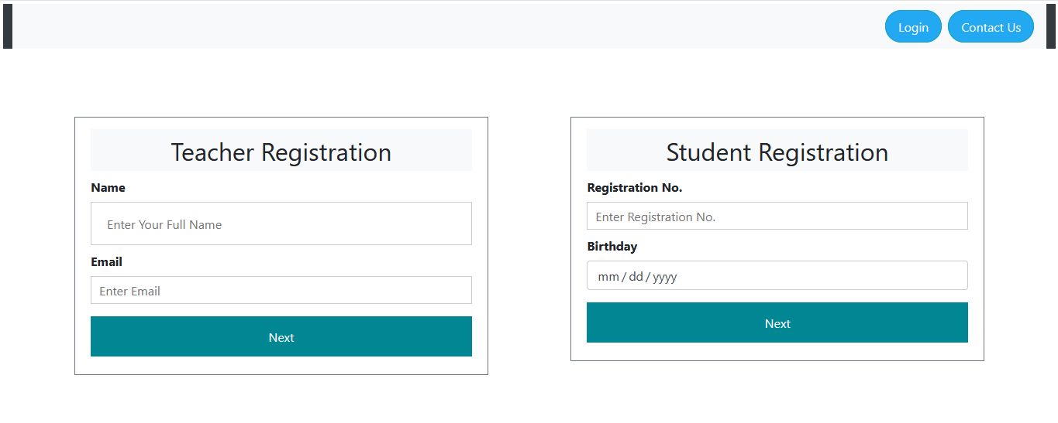
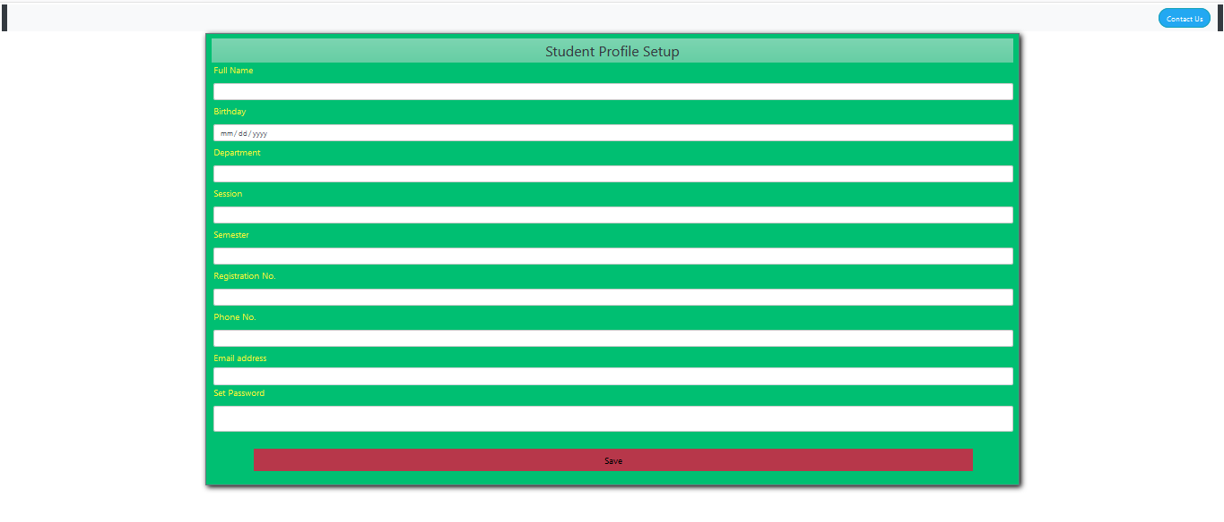
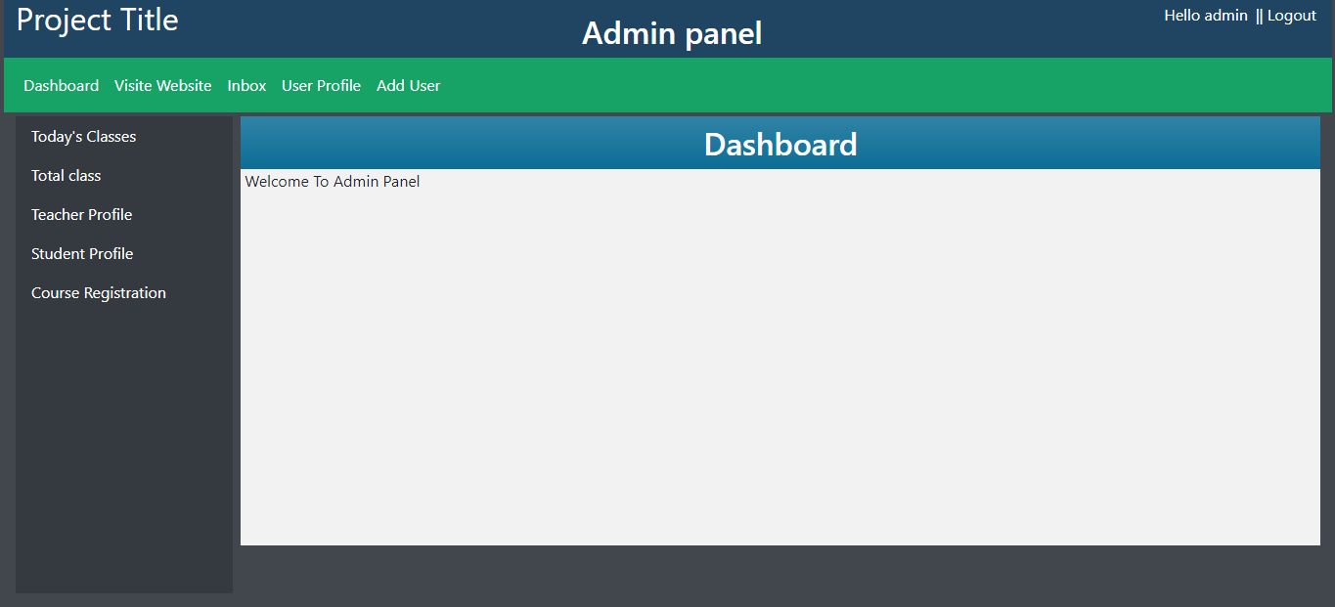
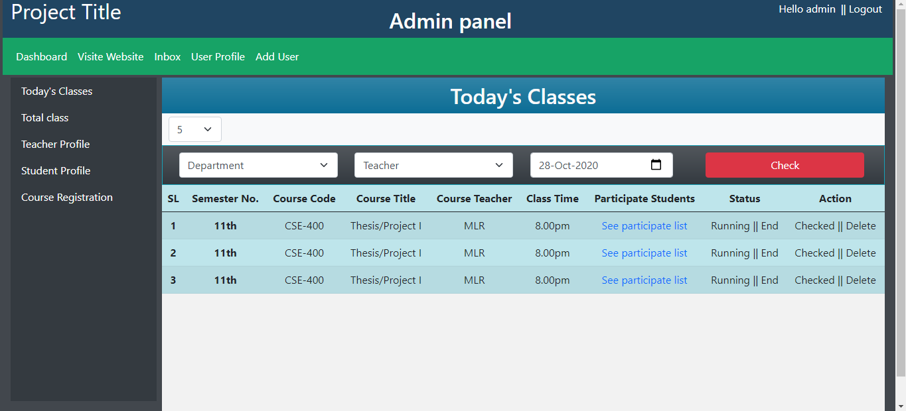
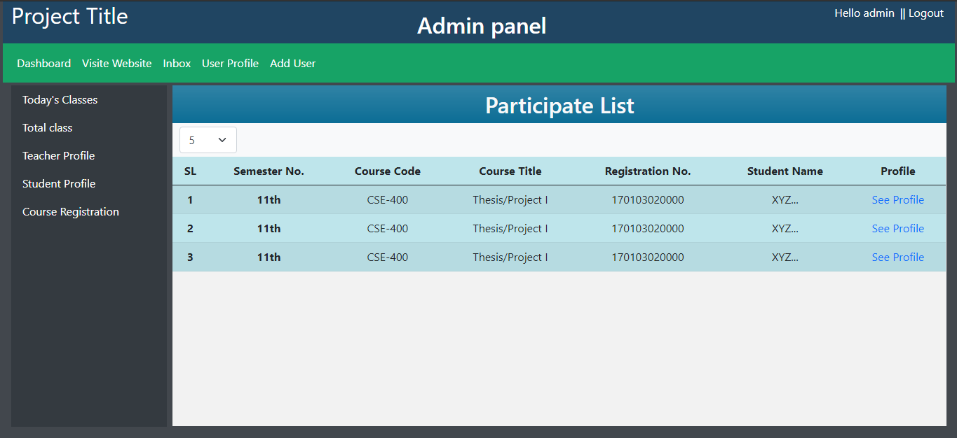
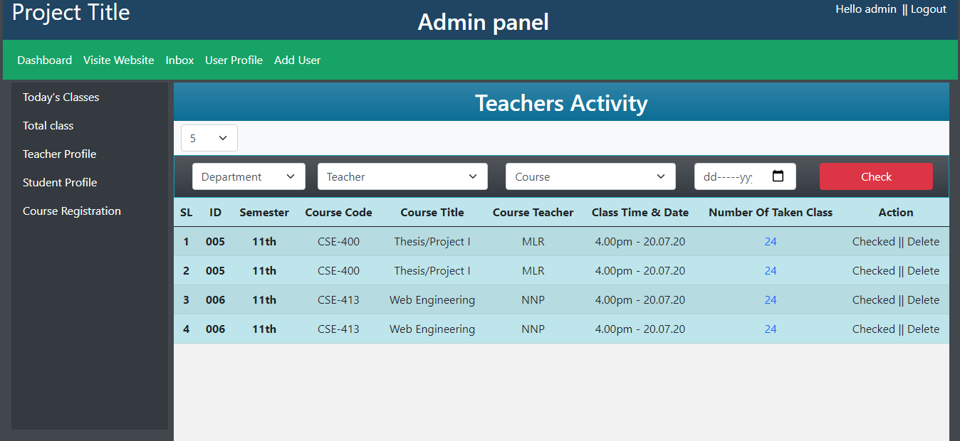
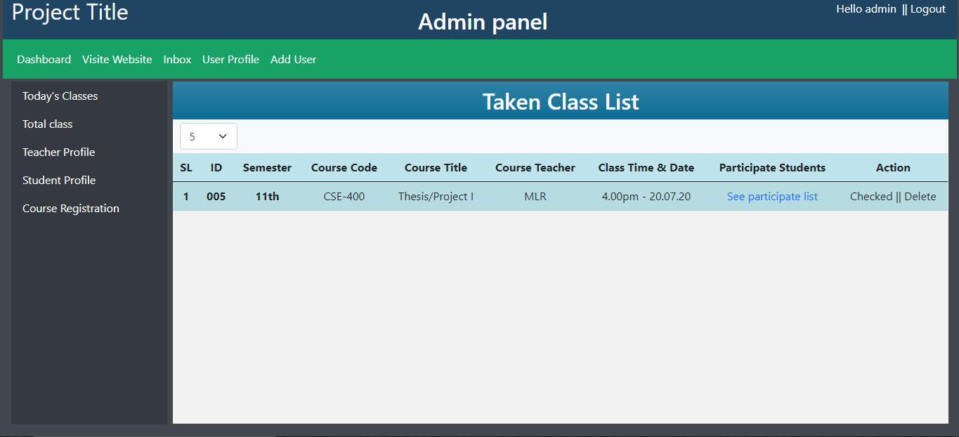
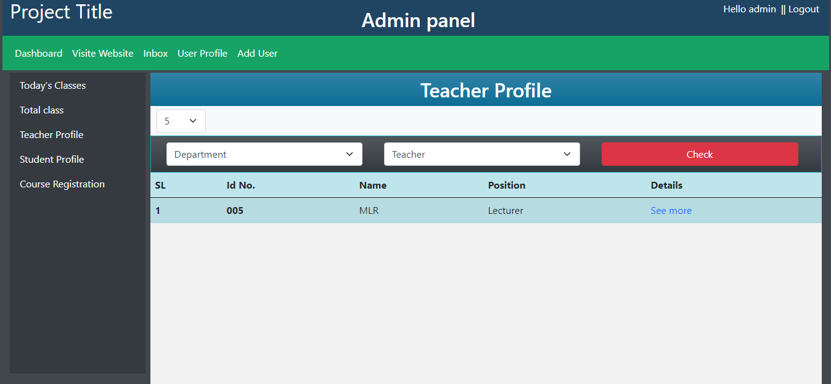
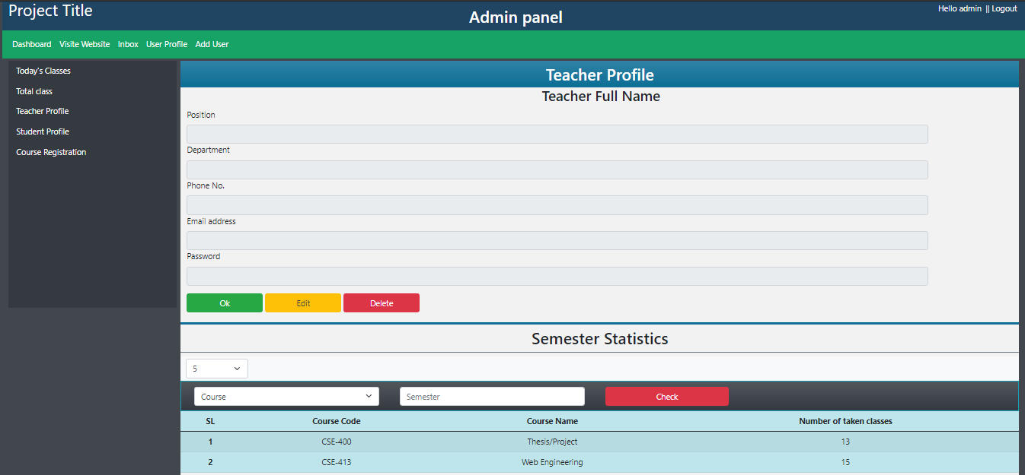
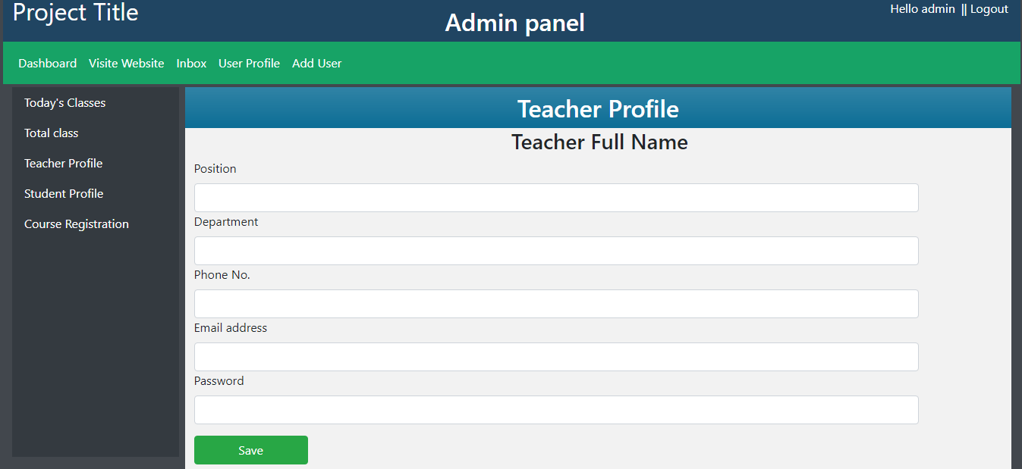
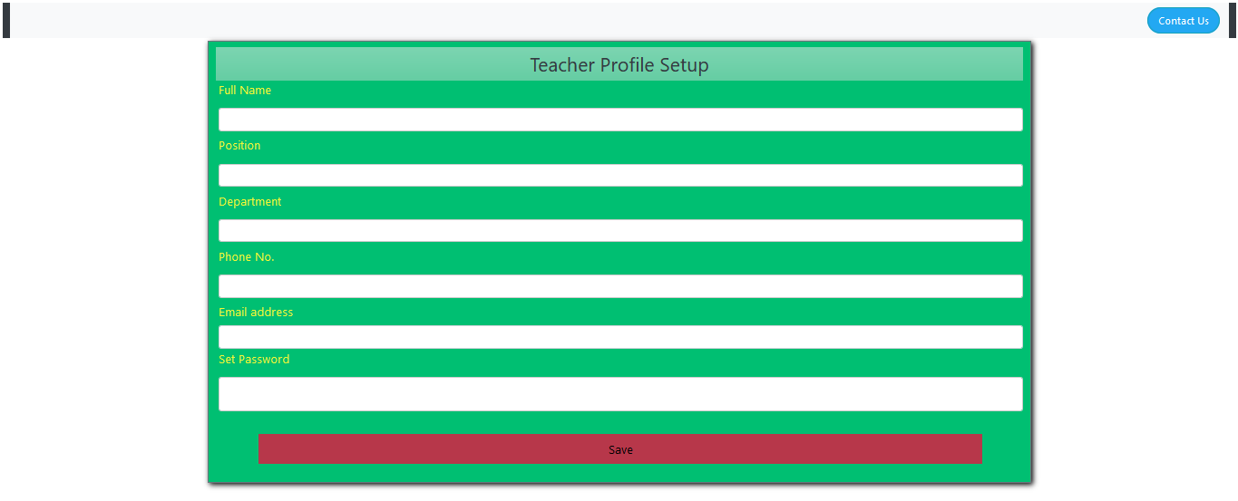
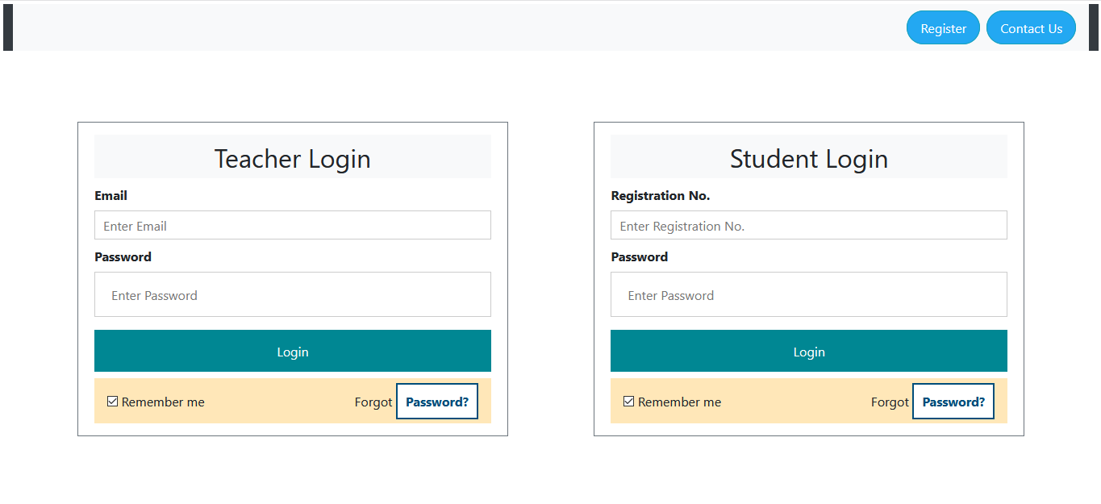
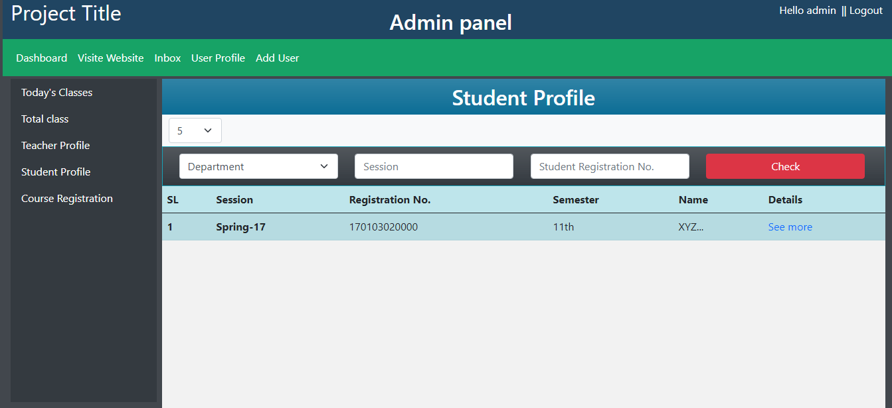
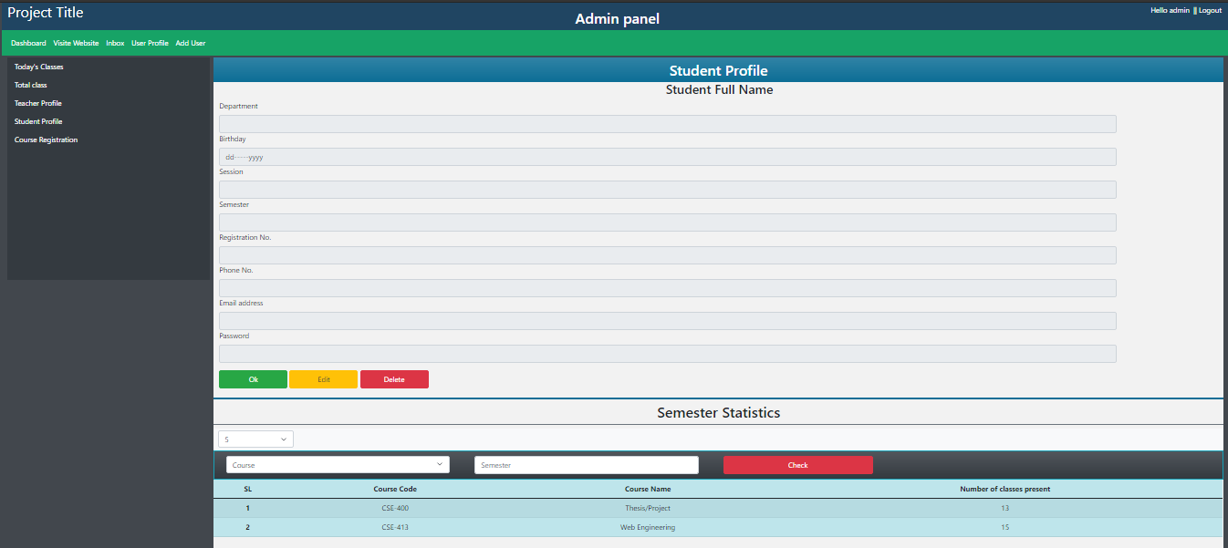
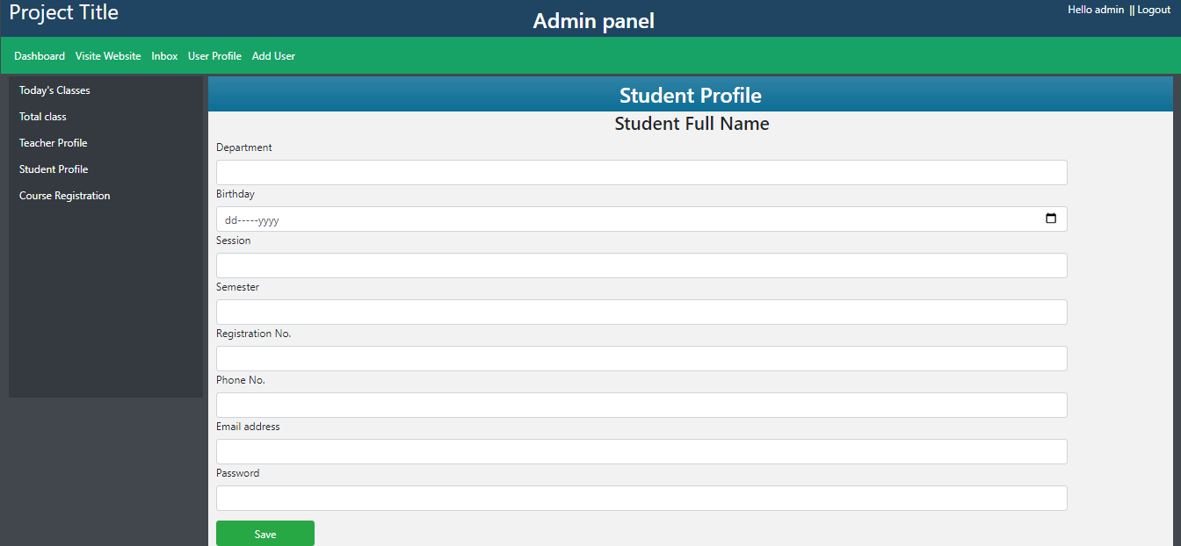
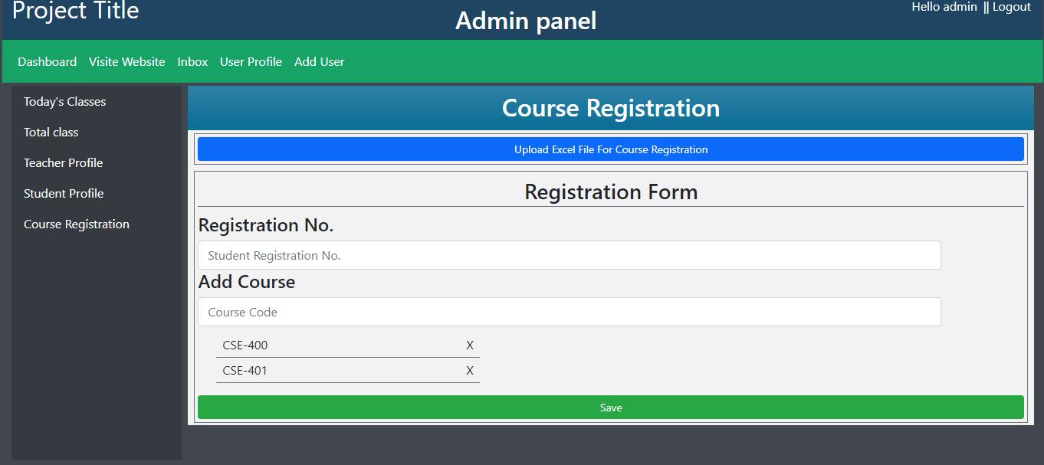
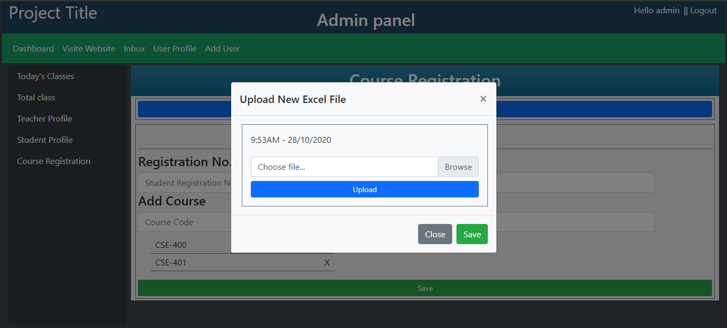
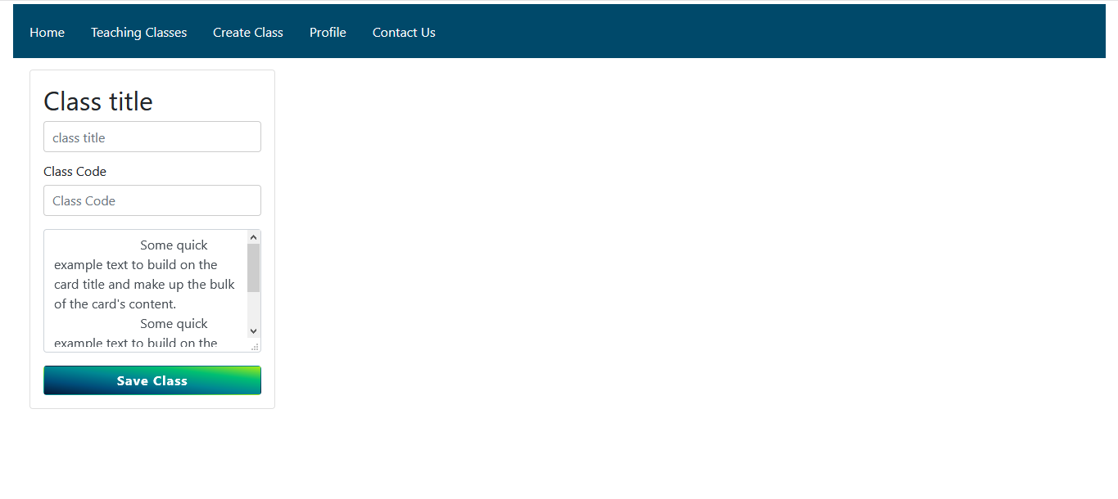
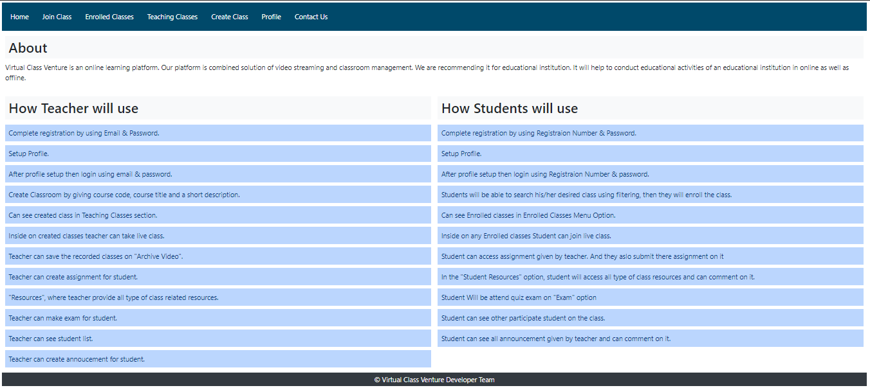
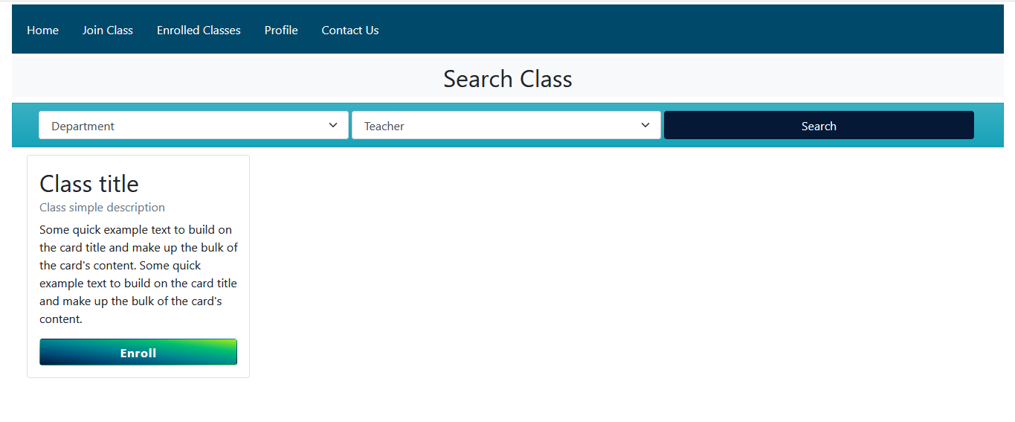
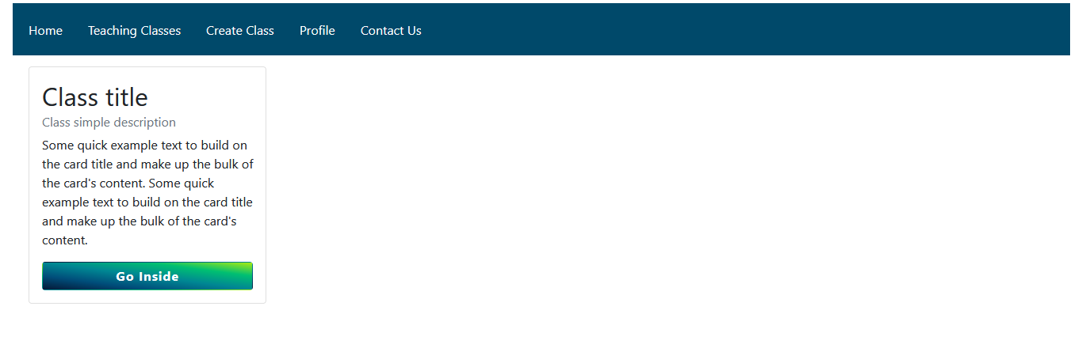
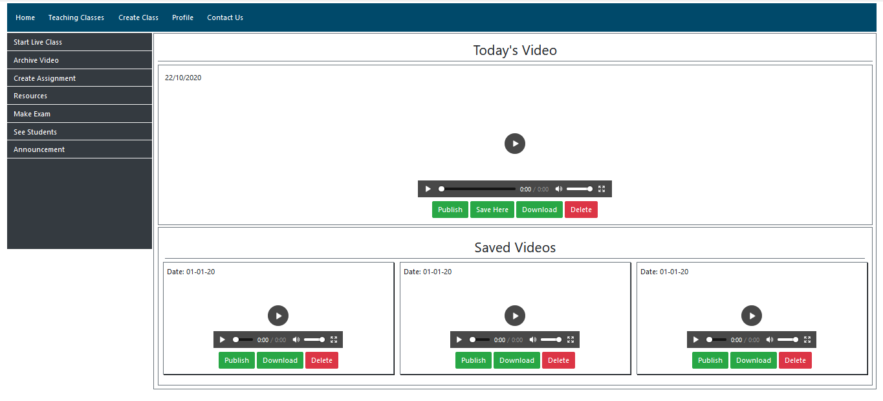
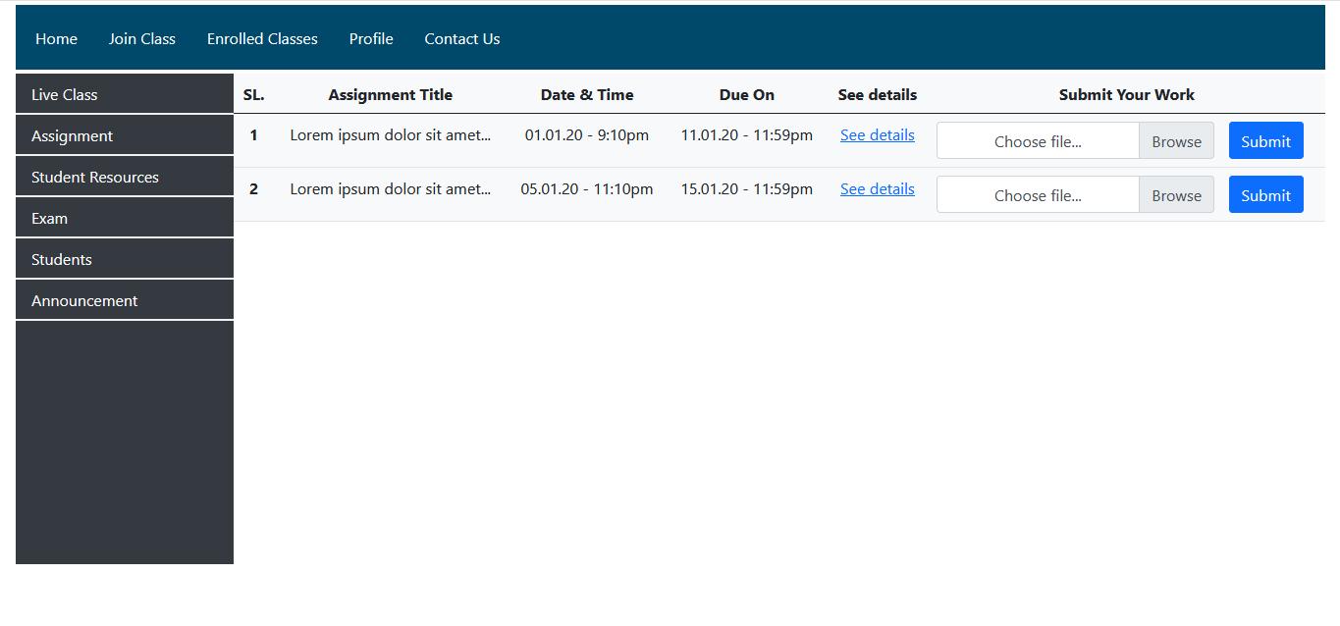
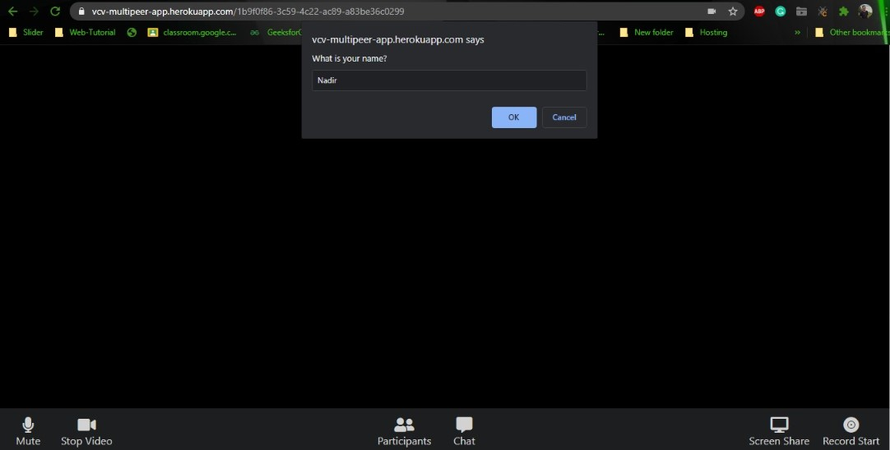
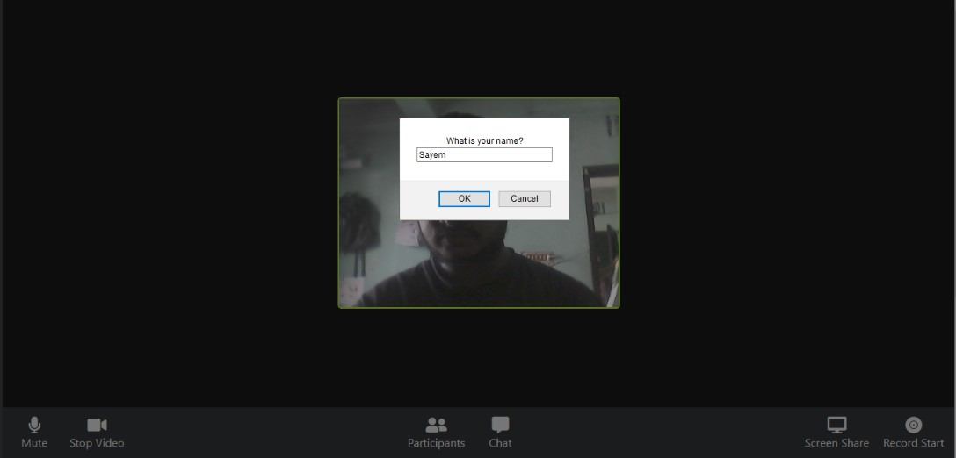
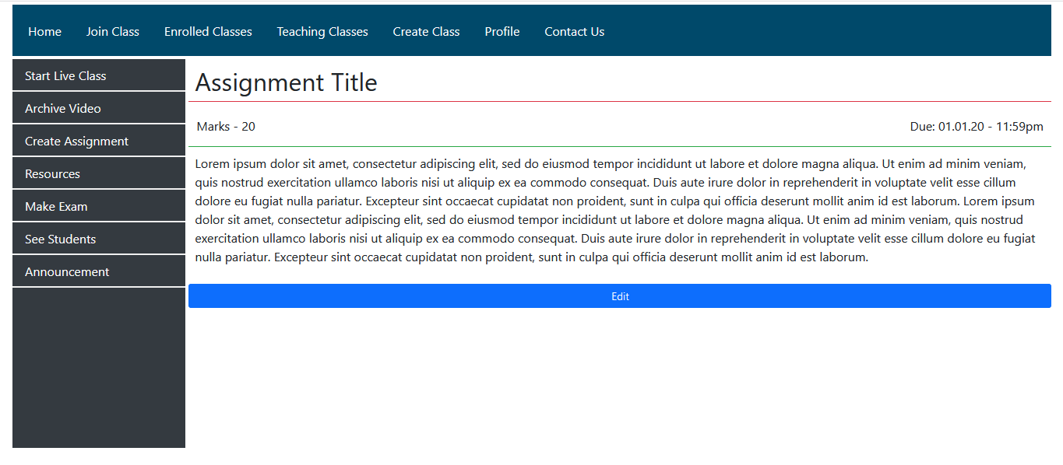
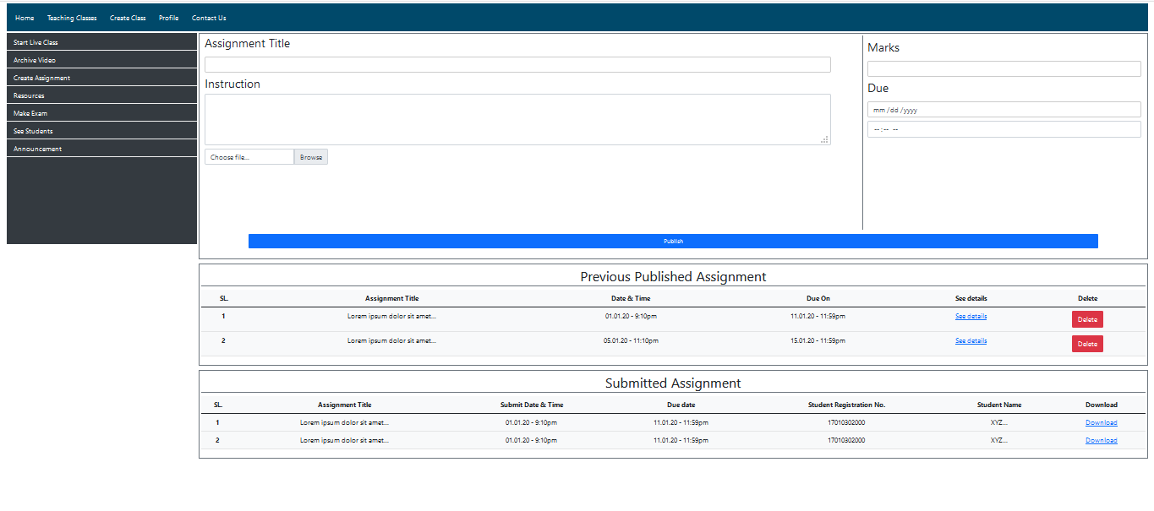
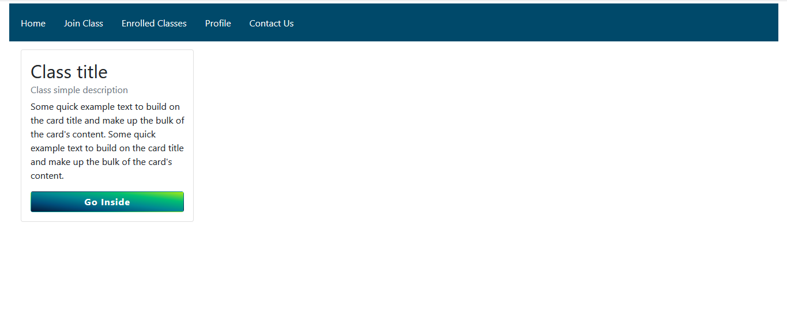
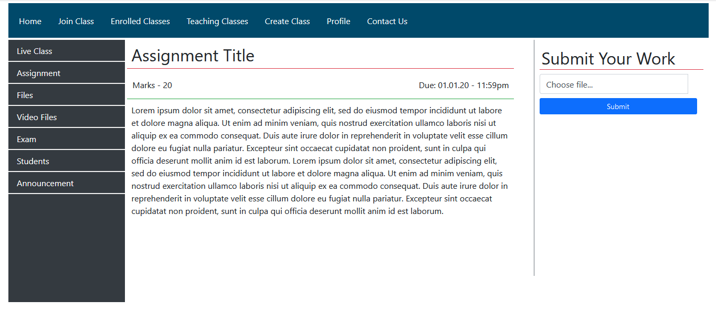
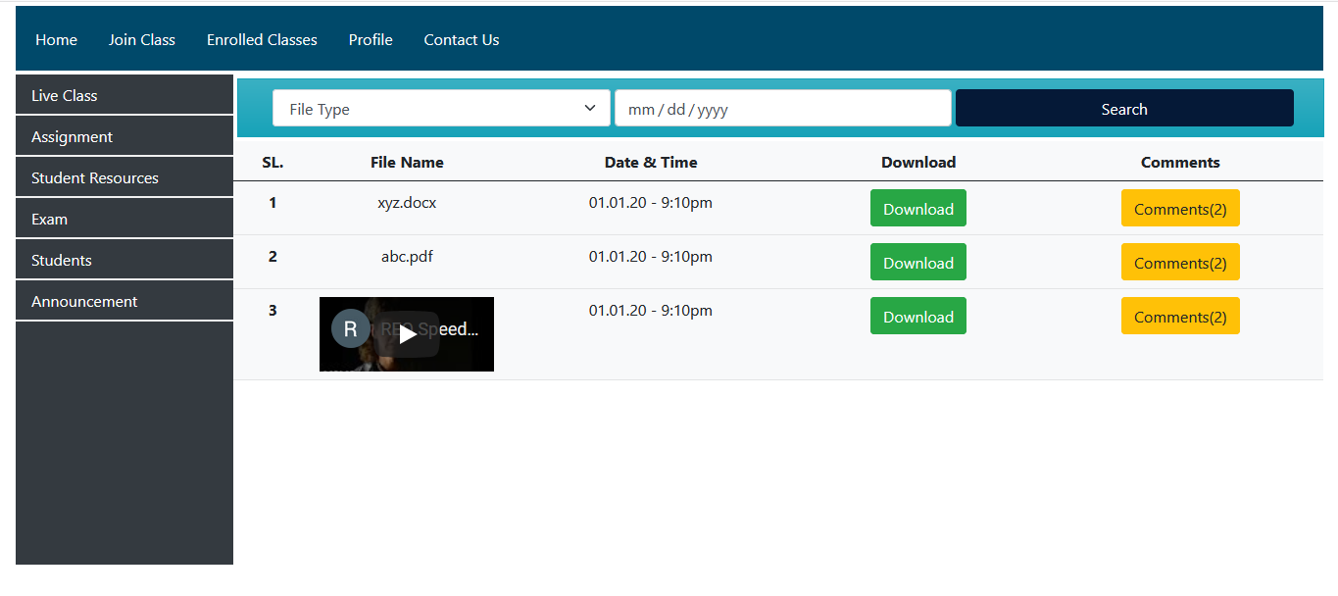
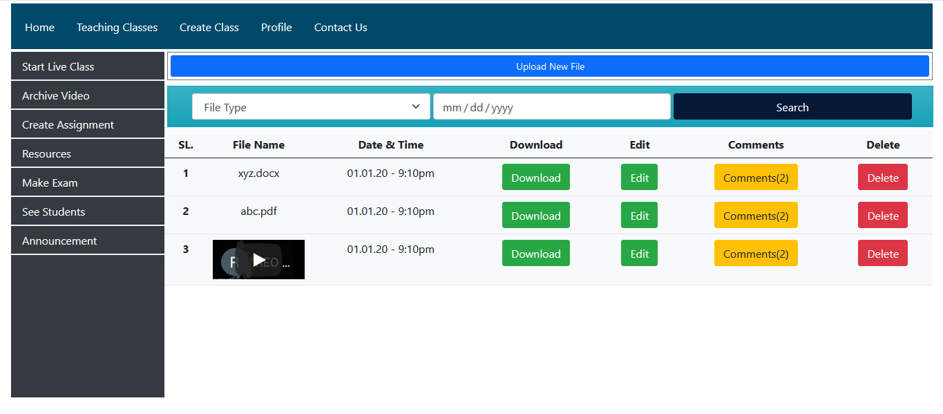
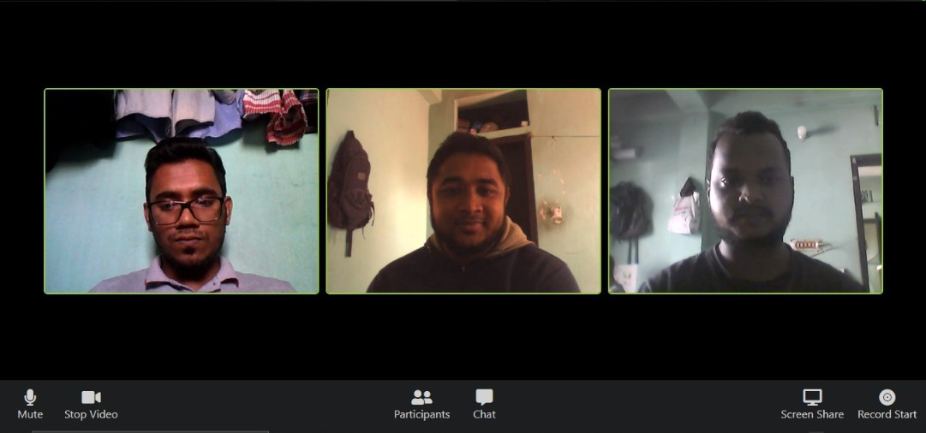
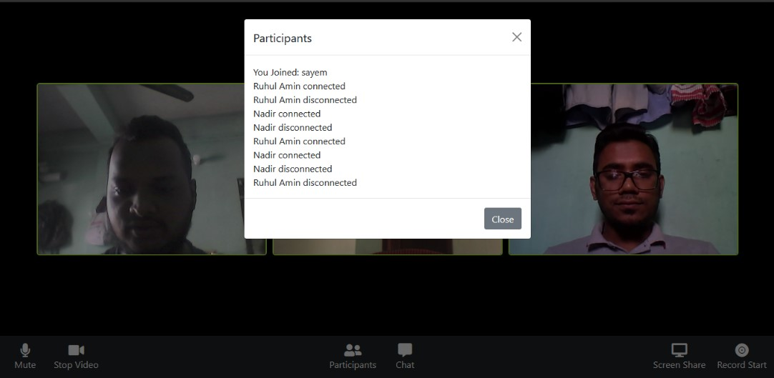
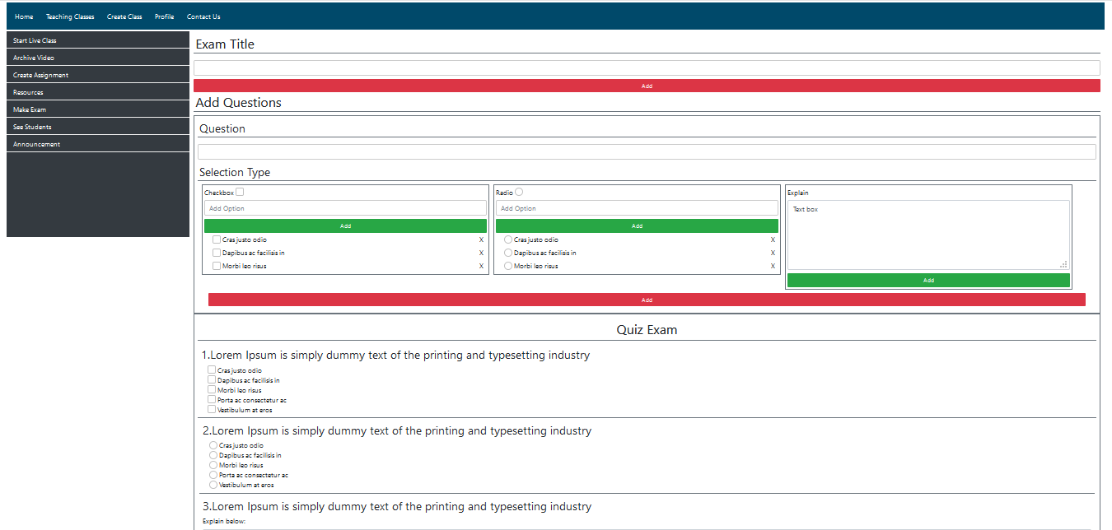
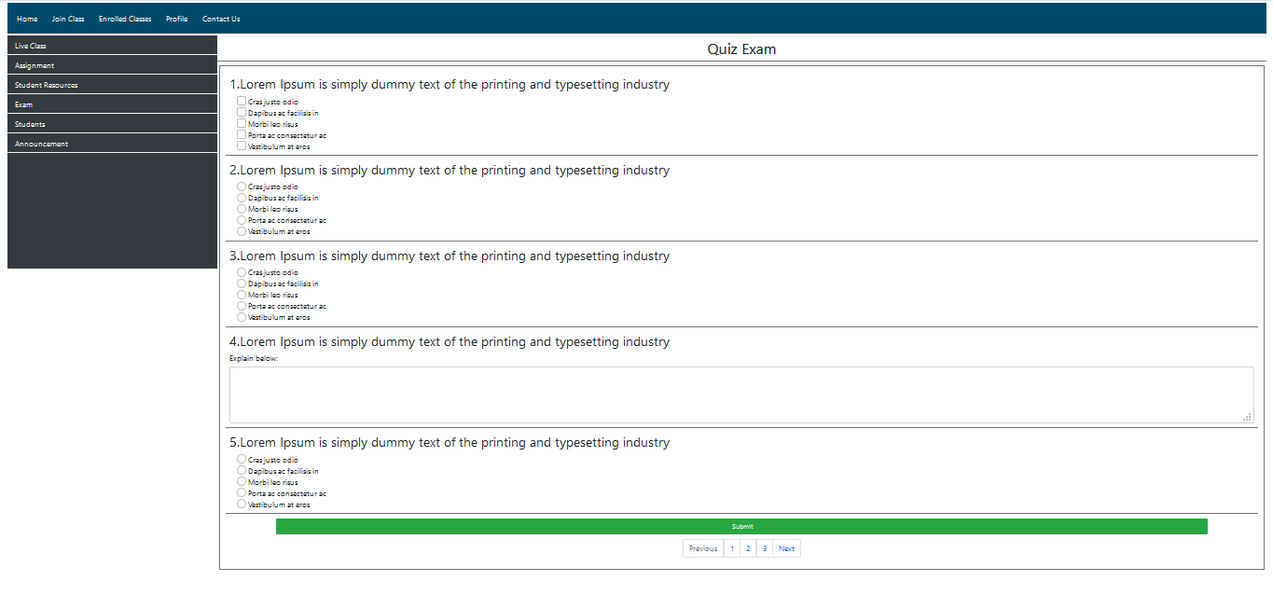
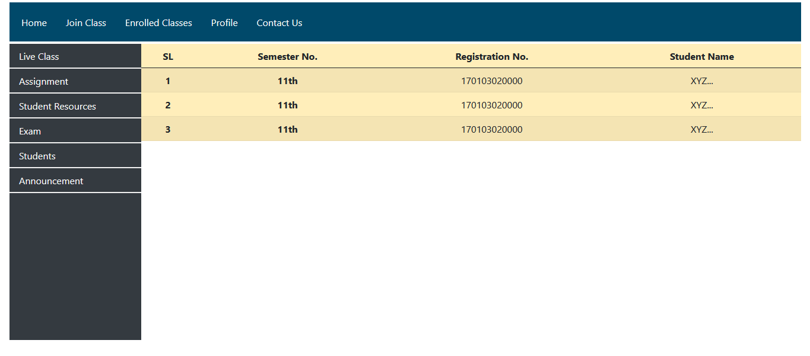
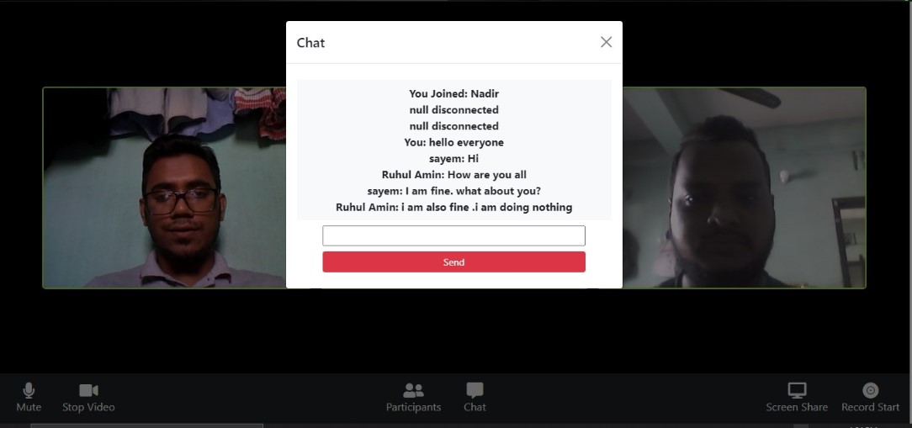
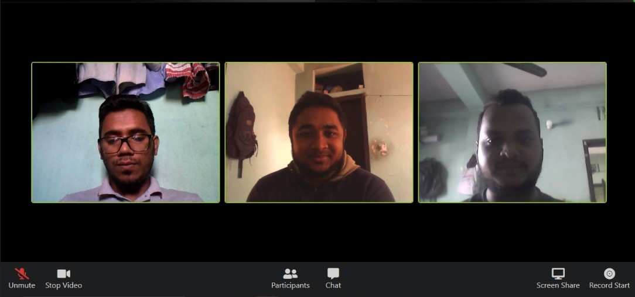
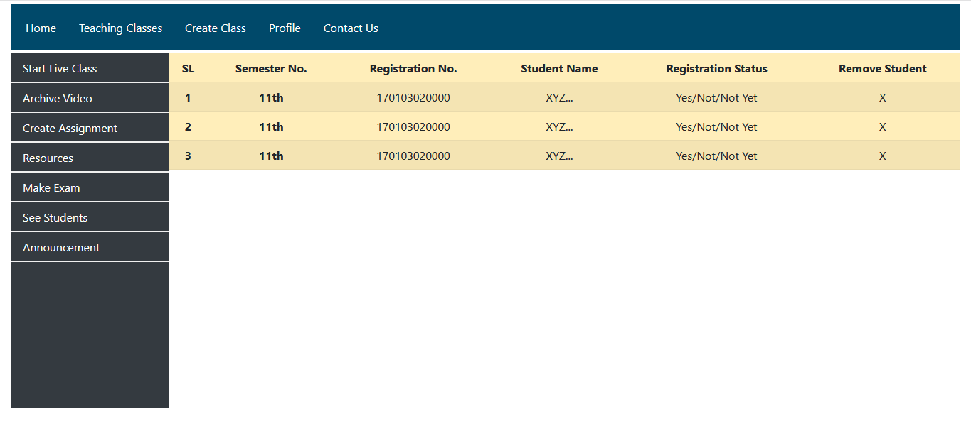
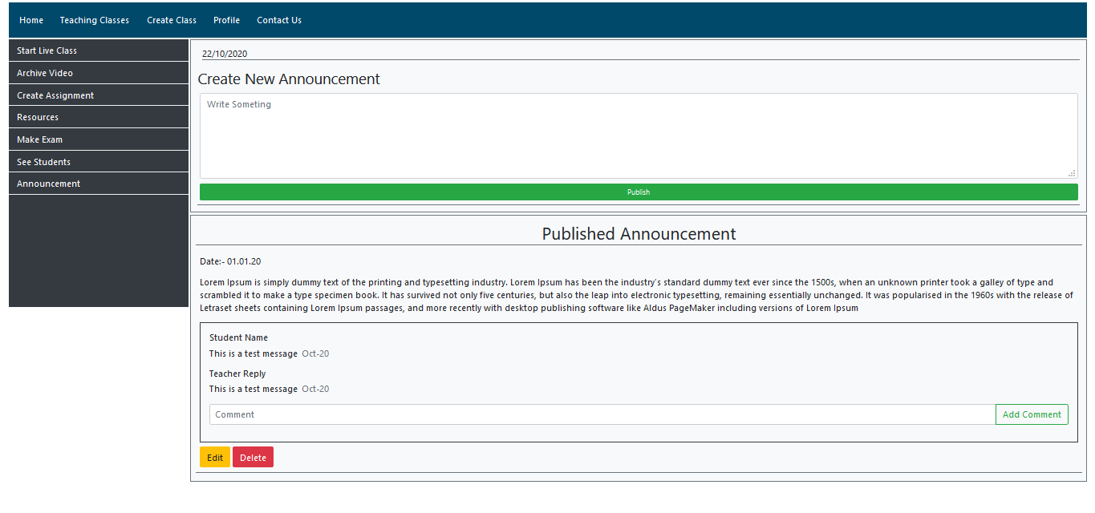
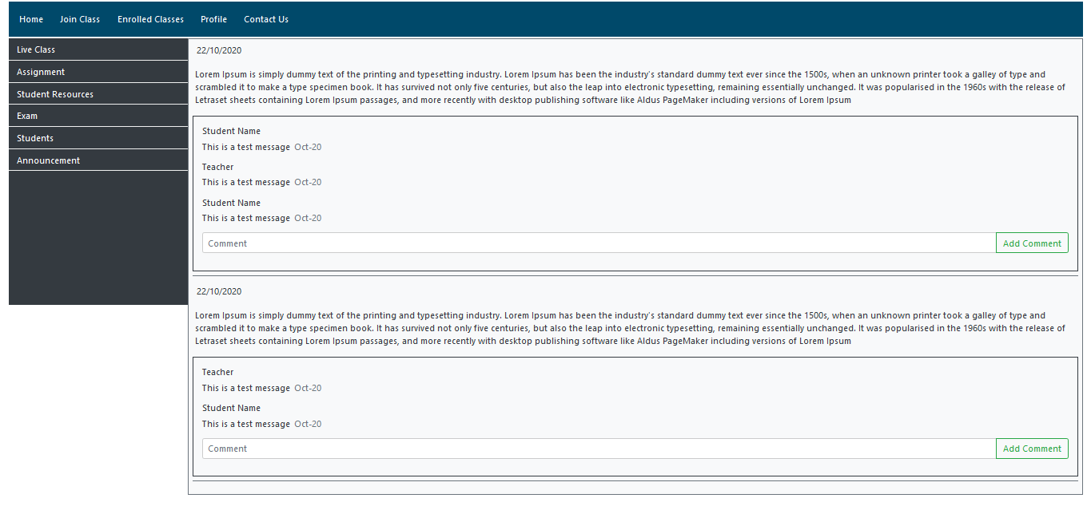
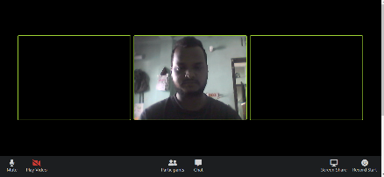
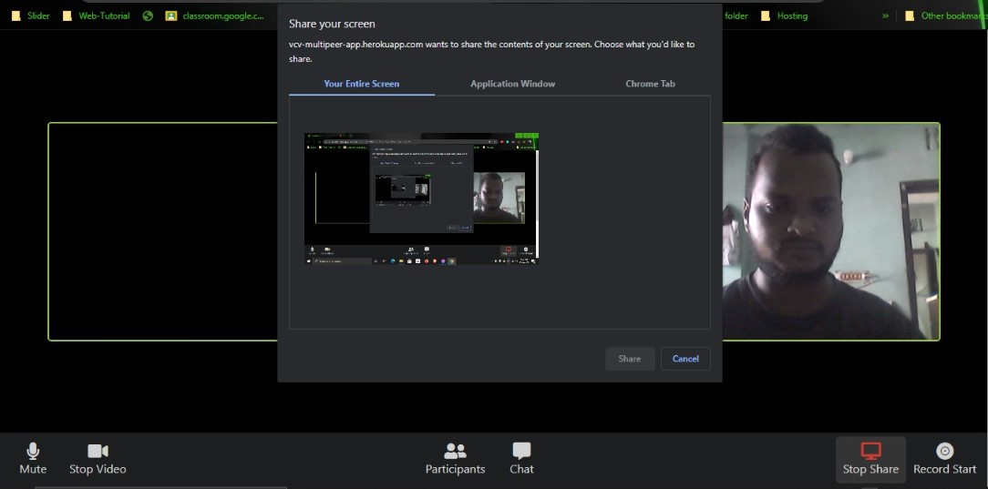
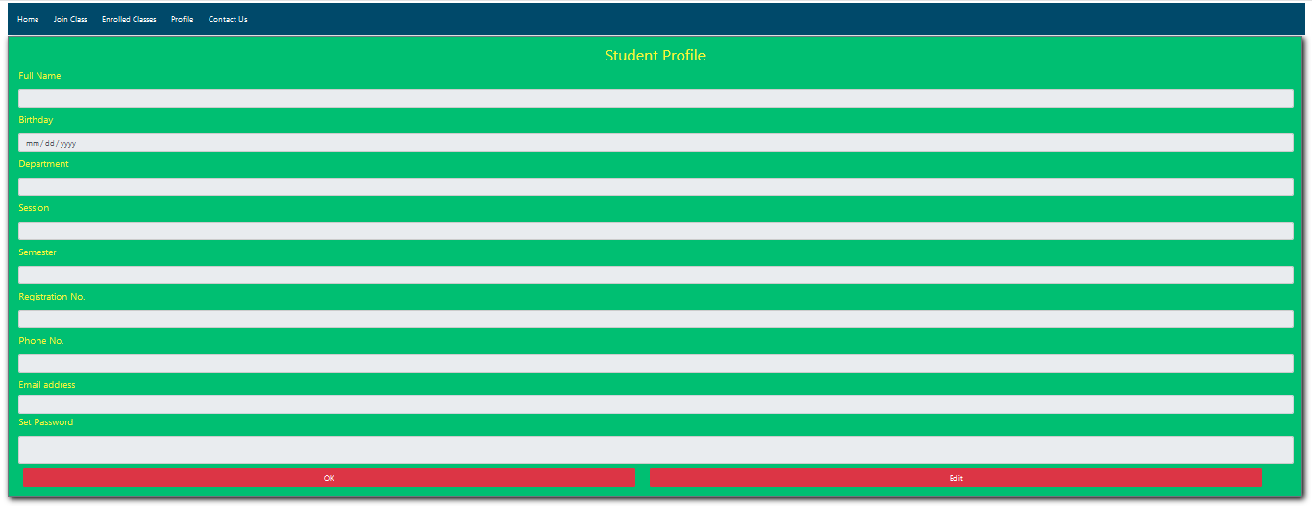
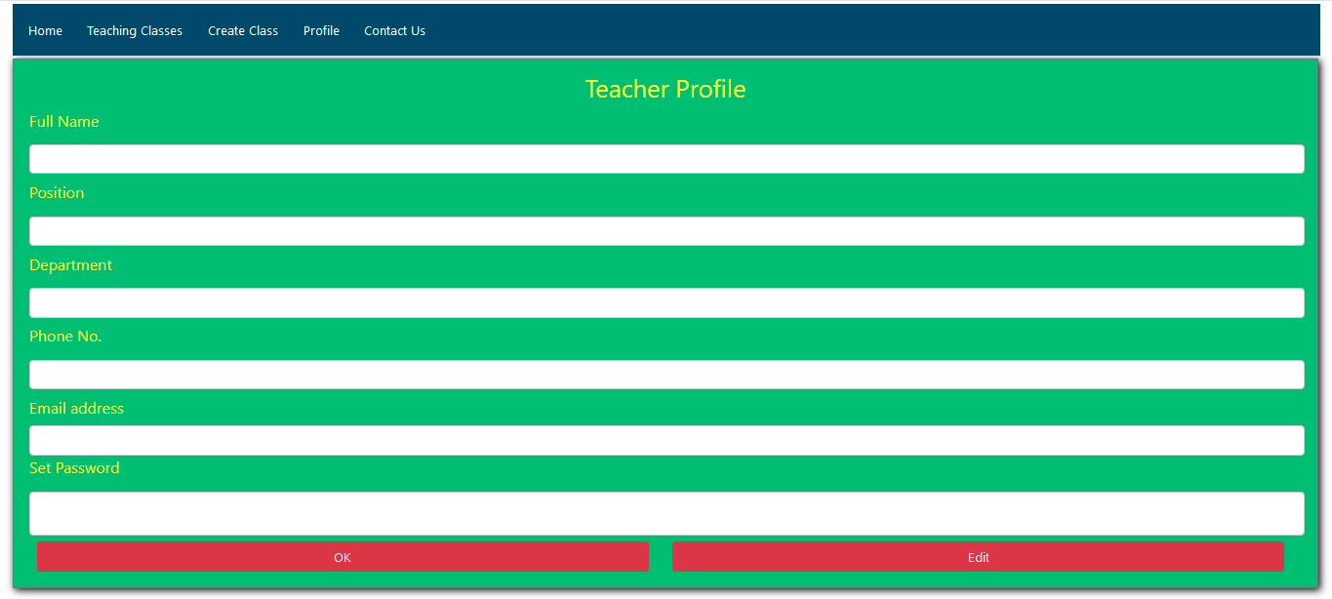
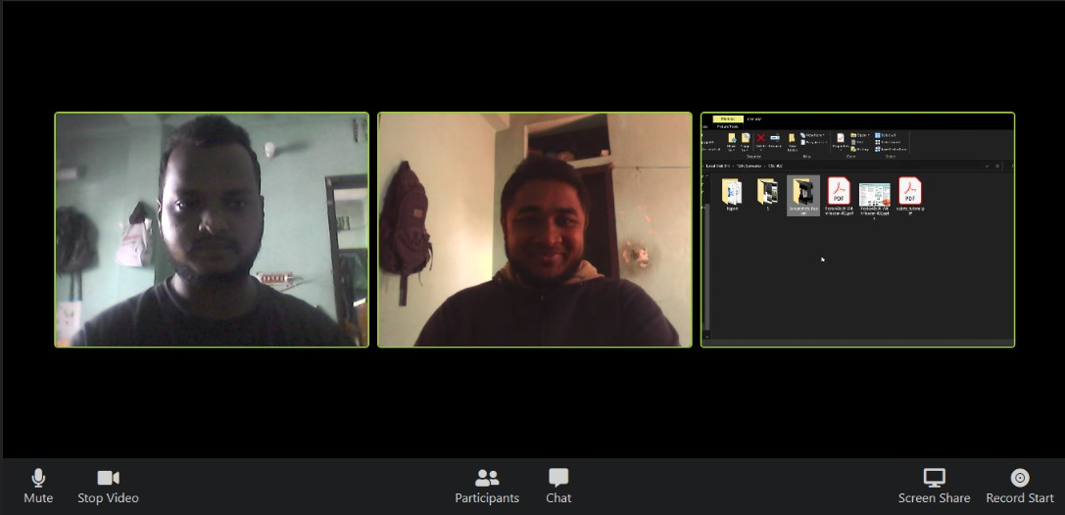
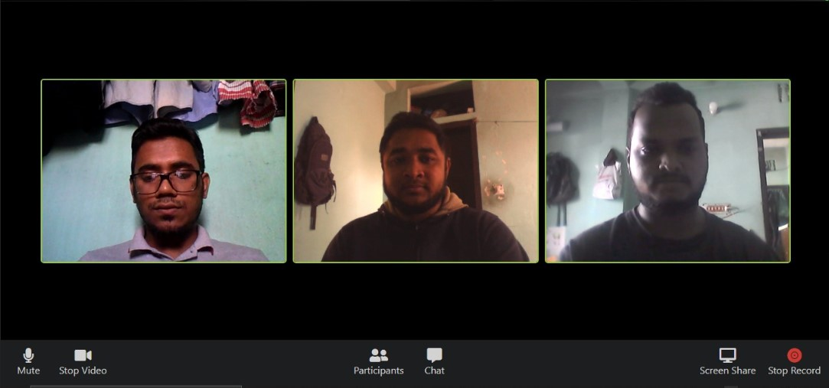
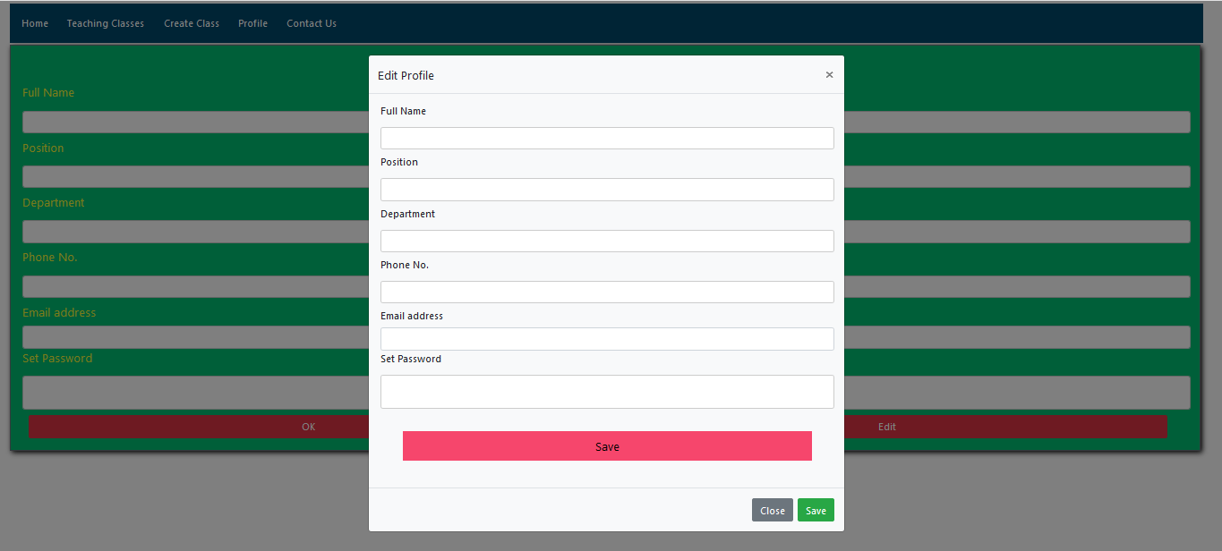
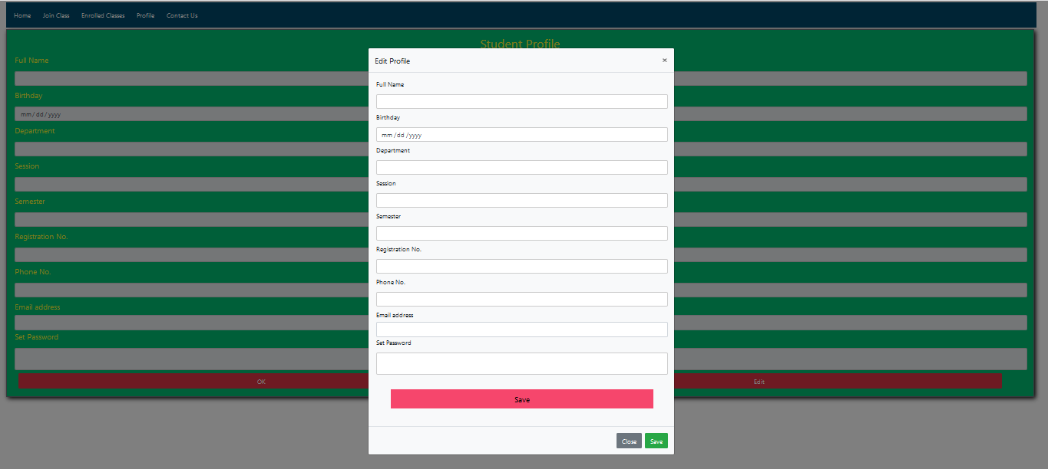
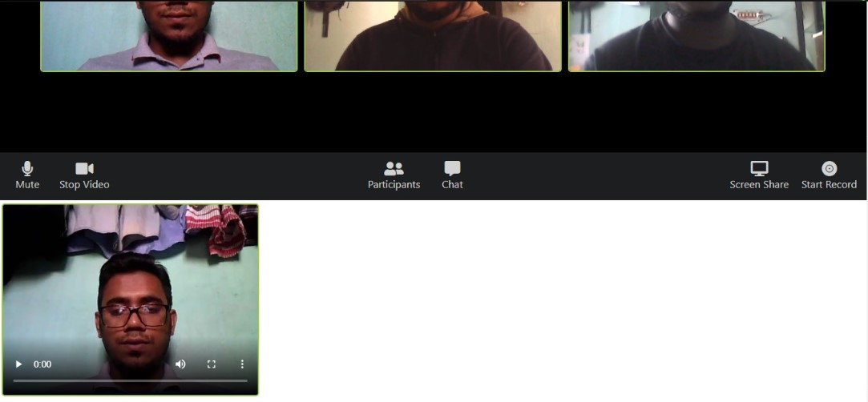

Virtual Class Venture for CSE 402 at 22.02.2021
Md. Asif Muntasir, ID: 170103020002, Email: asifmuntasirshuaib@gmail.com, Syed Nadir Ahmed, ID: 170103020010, Email: syednadirahmed2014@gmail.com
Proposed Main Features:
Our project main target was to create video streaming based on webrtc.
Screen controlling and Screen sharing while video streaming.
Audio mute/unmute option.
Chat between teacher and student while video streaming.
Record teacher’s activity during video streaming and save it on the system.
Teacher can see the student participate list.
Basic CRUD functionality (Profile create and maintenance by teacher and student).
Admin panel for monitoring teacher and student activities and also manage other admin activities.
Proposed Additional Features:
Basic CRUD functionality include file upload, download, delete etc.
Comment on post both teacher and student.
Teacher will be able to take attendance dynamically.
Teacher will be able to test student in quiz format.
Create announcement by teacher.
Teacher will be able to take assignment from student through the system.
Tools that we have used:
We have used Bootstrap5 (Alpha) version for designing webpages with some custom CSS.
For implementing WebRTC we have used Node.js.
We have used JavaScript to design some feature.
For developing some features we have used jQuery.
We have used PeerJS library for peer to peer connection.
User Interface Design:
Registration form
Admin Interface:
Admin Dashboard
Today Classes
Participate List
Teachers Activity
Student Profile Setup
Taken Class
Teacher Profile
Teacher Profile View
Teacher Profile Edit
Teacher Profile Setup
Teacher Login
Student Login
Student Profile
Student Profile View
Student Profile Edit
Course Registration Manually
Course Registration With CSV File
Create Class
Home Page
Join Class
Works Done:
We have completed our frontend.
In this semester we have completed audio mute-unmute, video play-stop, participant list view, chat, screenshare, video recording and downloading part of RTC.
We also have completed multipeer connection. All of the work which we defined above that we have implemented with multipeer connection.
Future Work:
We will complete screen control, video recording and database related work in future.
Contribution:
Nadir has done frontend, chat, participant list and Asif has done other part of WebRTC like as audio, video play-stop, screen share, record.
We both understood every single line of code there is in the project whether it is frontend and RTC.
For live test visit: https://vcv-multipeer-app.herokuapp.com/
Teaching Class
Archive Video
Assignment Submission
RTC Interface:
Host Interface when he/she visit the link
User interface when host share link with user
Assignment Details
Create Assignment
Enrolled Class
Assignment Details for Student
Student Resources
Resources
After successful confirmation host and user connected with each other
Participate list interface when host or user click on participant button
Make Exam
Student Exam Paper
Student Participate List
Chat interface for both host and user
Host and user both can mute-unmute their audio
Participate Student List
Create Announcement
Get Announcement
Stop camera interface for both host and user
Pop-up screen share permission when host or user click on screen share button
Student Profile
Teacher Profile
Shared screen by host
Recording state when user or host click on record button
Teacher Profile Edit
Student Profile Edit
When the video recording is finished, the video will be saved at the bottom of the main application
This is a general contact page. This can be used by both the student and the teacher for any query to the admin.
Supervised by: Noushad Sojib

